Slide 1
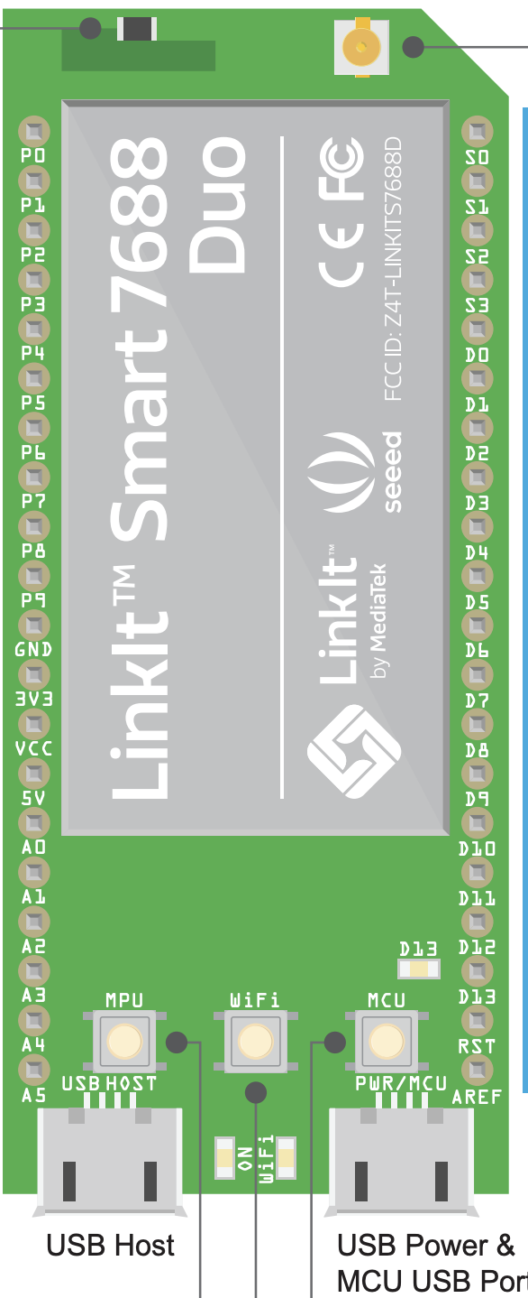

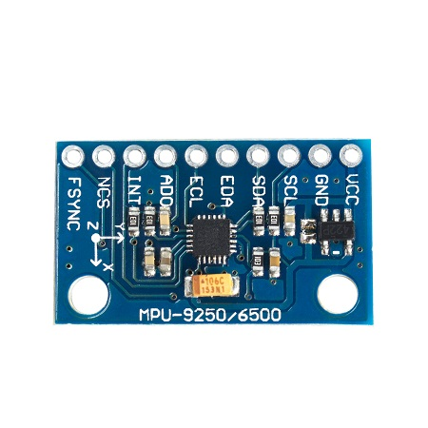
I2C
DATA BASE
LINKSMART 7688
MPU9250

Slide 2
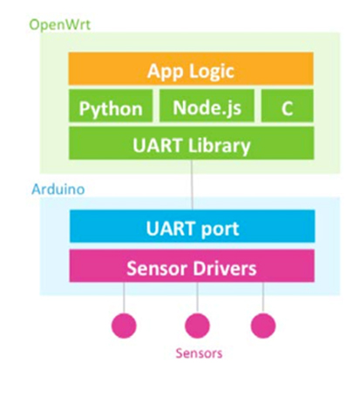
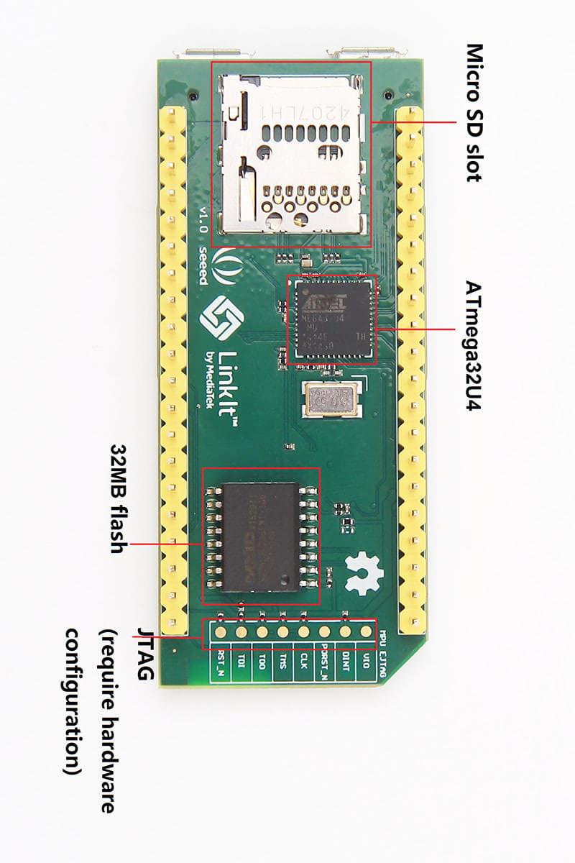

Slide 3
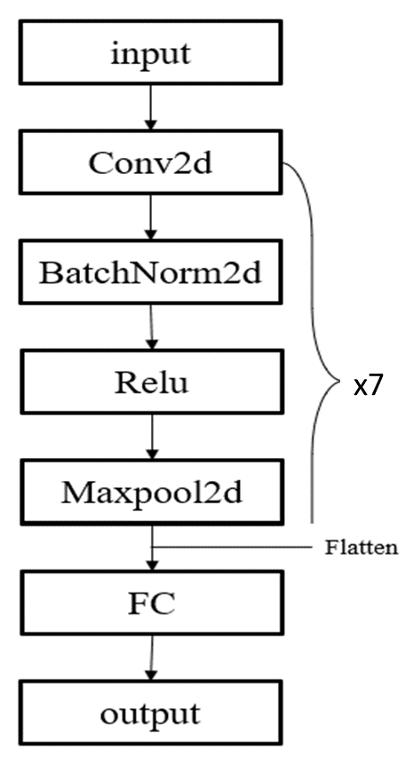
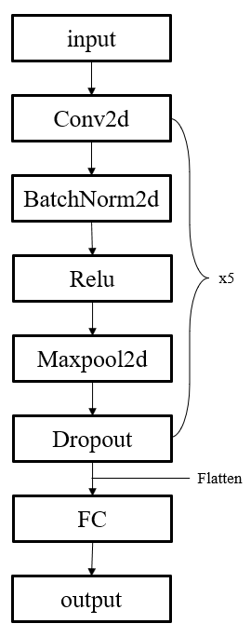
Input
Conv2d
BatchNorm2d
ReLU
Maxpool2d
FC
Output
x7
Flatten

Slide 4
MCU | 資料庫 | 輸入頻率
linkit (atmega32u4) | X | 300Hz
linkit (atmega32u4) | MongoDB | 150Hz
arduino mega (I2C) | X | 400-500 Hz
arduino mega (SPI) | X | 300-400 Hz

Slide 5
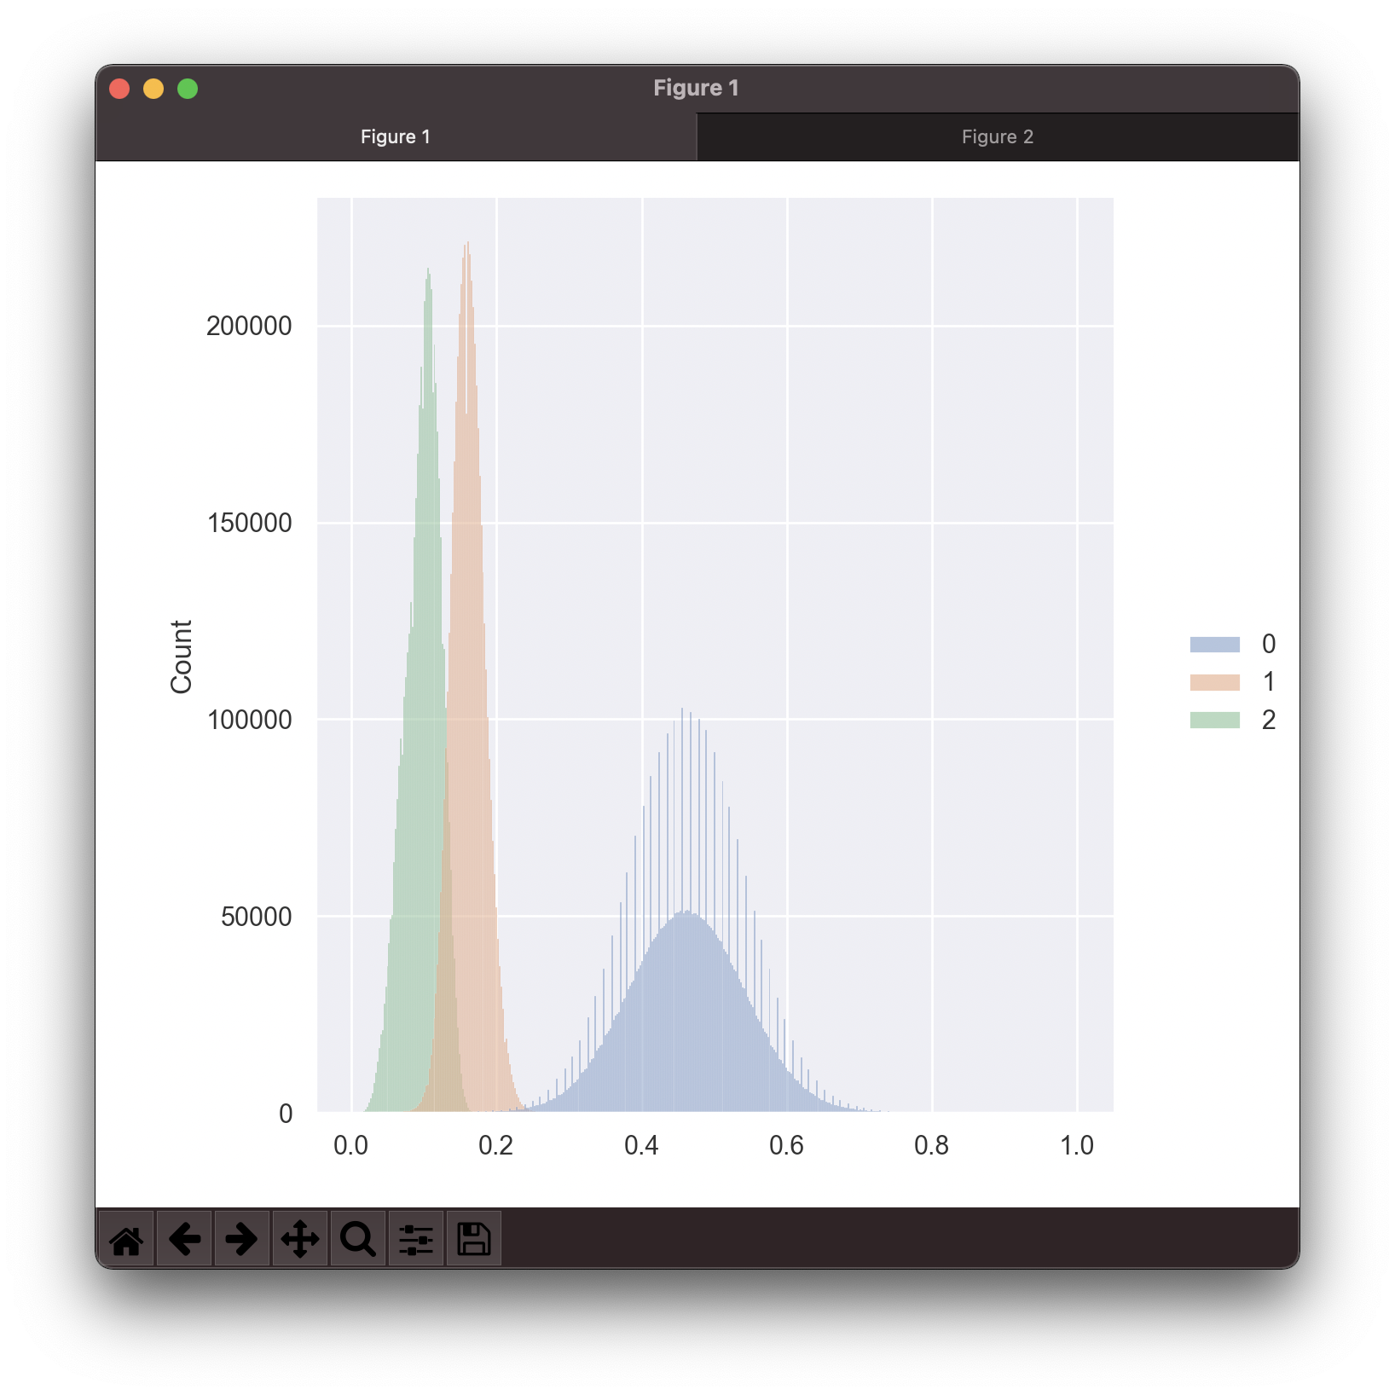
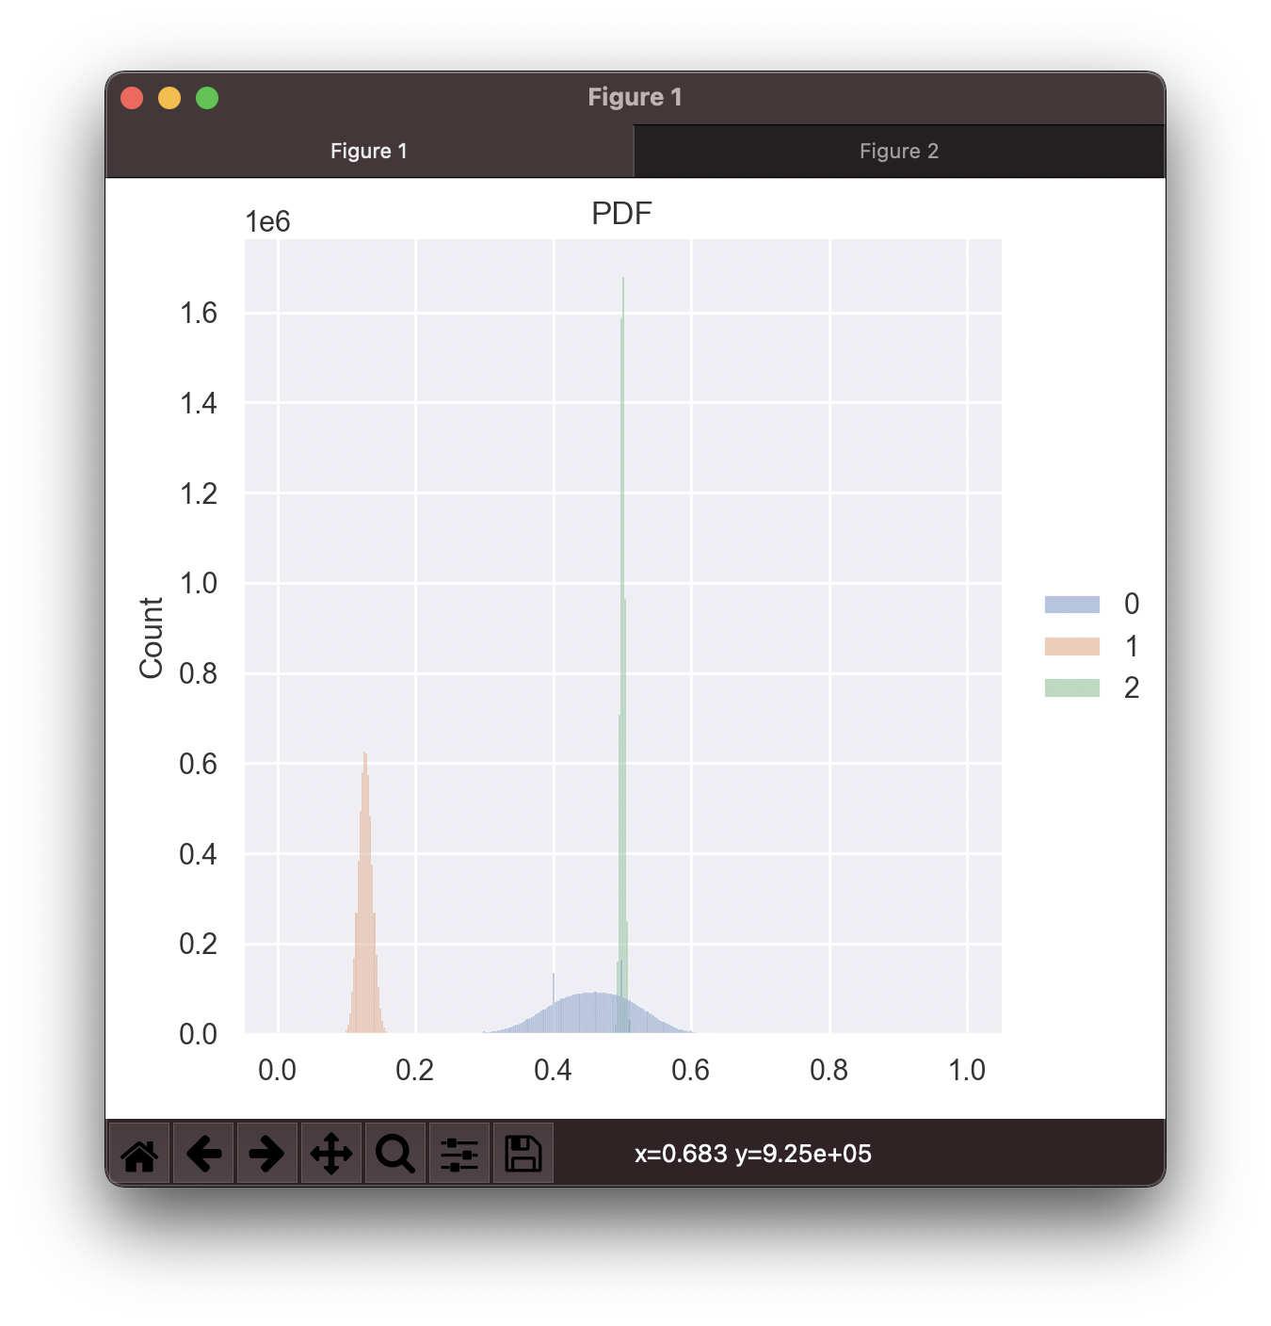
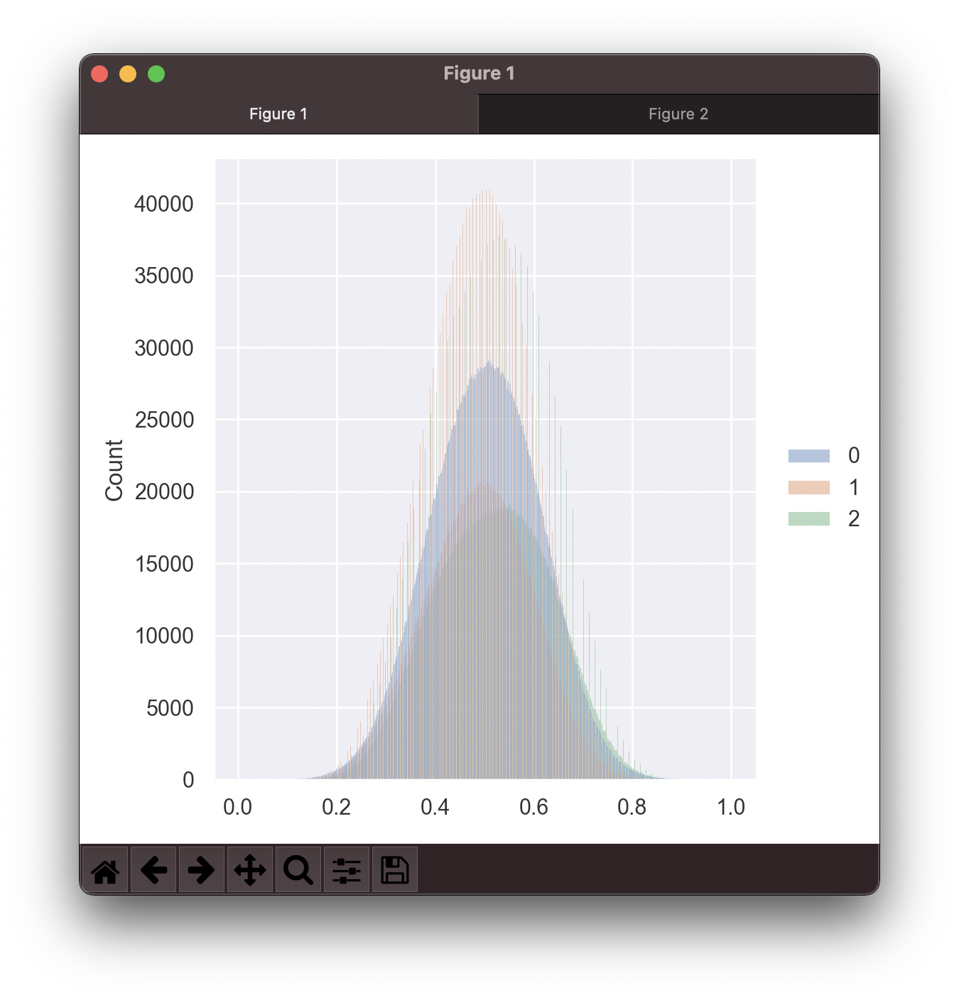
Sensor
Data
Delete
Outlier
Normalize
Training

Slide 6
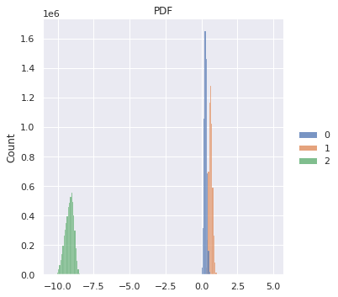
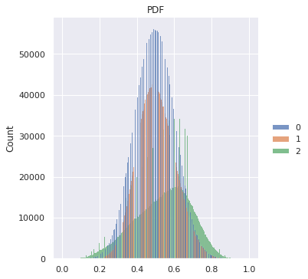
Sensor Data
Normalize (1,0)
Training
Delete Outlier
Sensor Data
算出4std 內的 mean,std,Mix,Min
Normalize (1,0)
Training

Slide 7
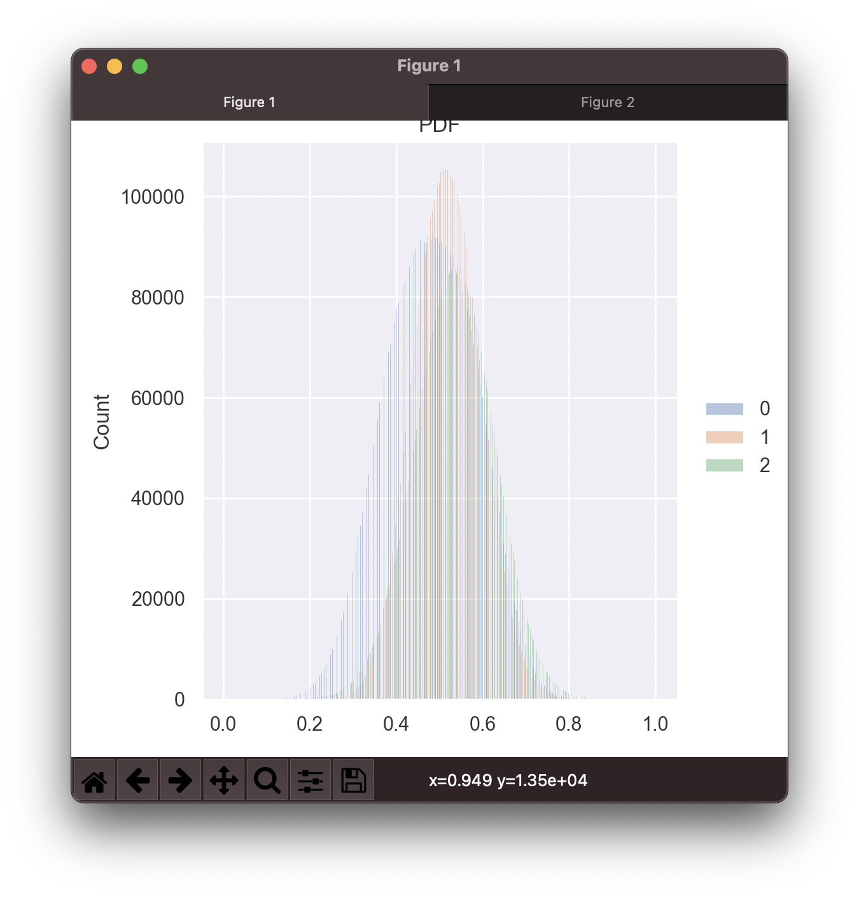
原始數據
刪除離群值 + 正歸化
刪除離群值 + 正歸化

Slide 8
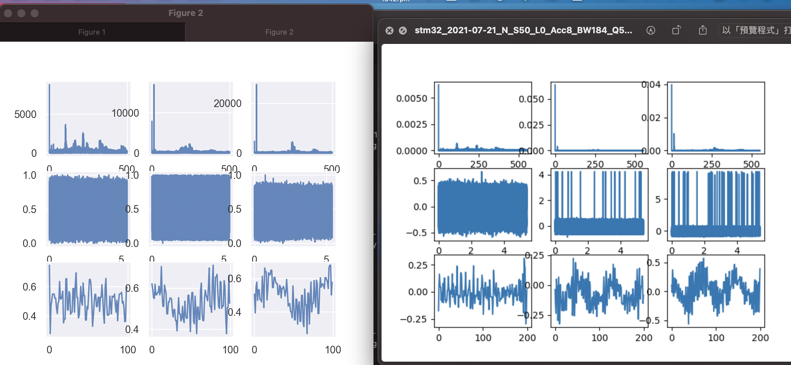

Slide 9
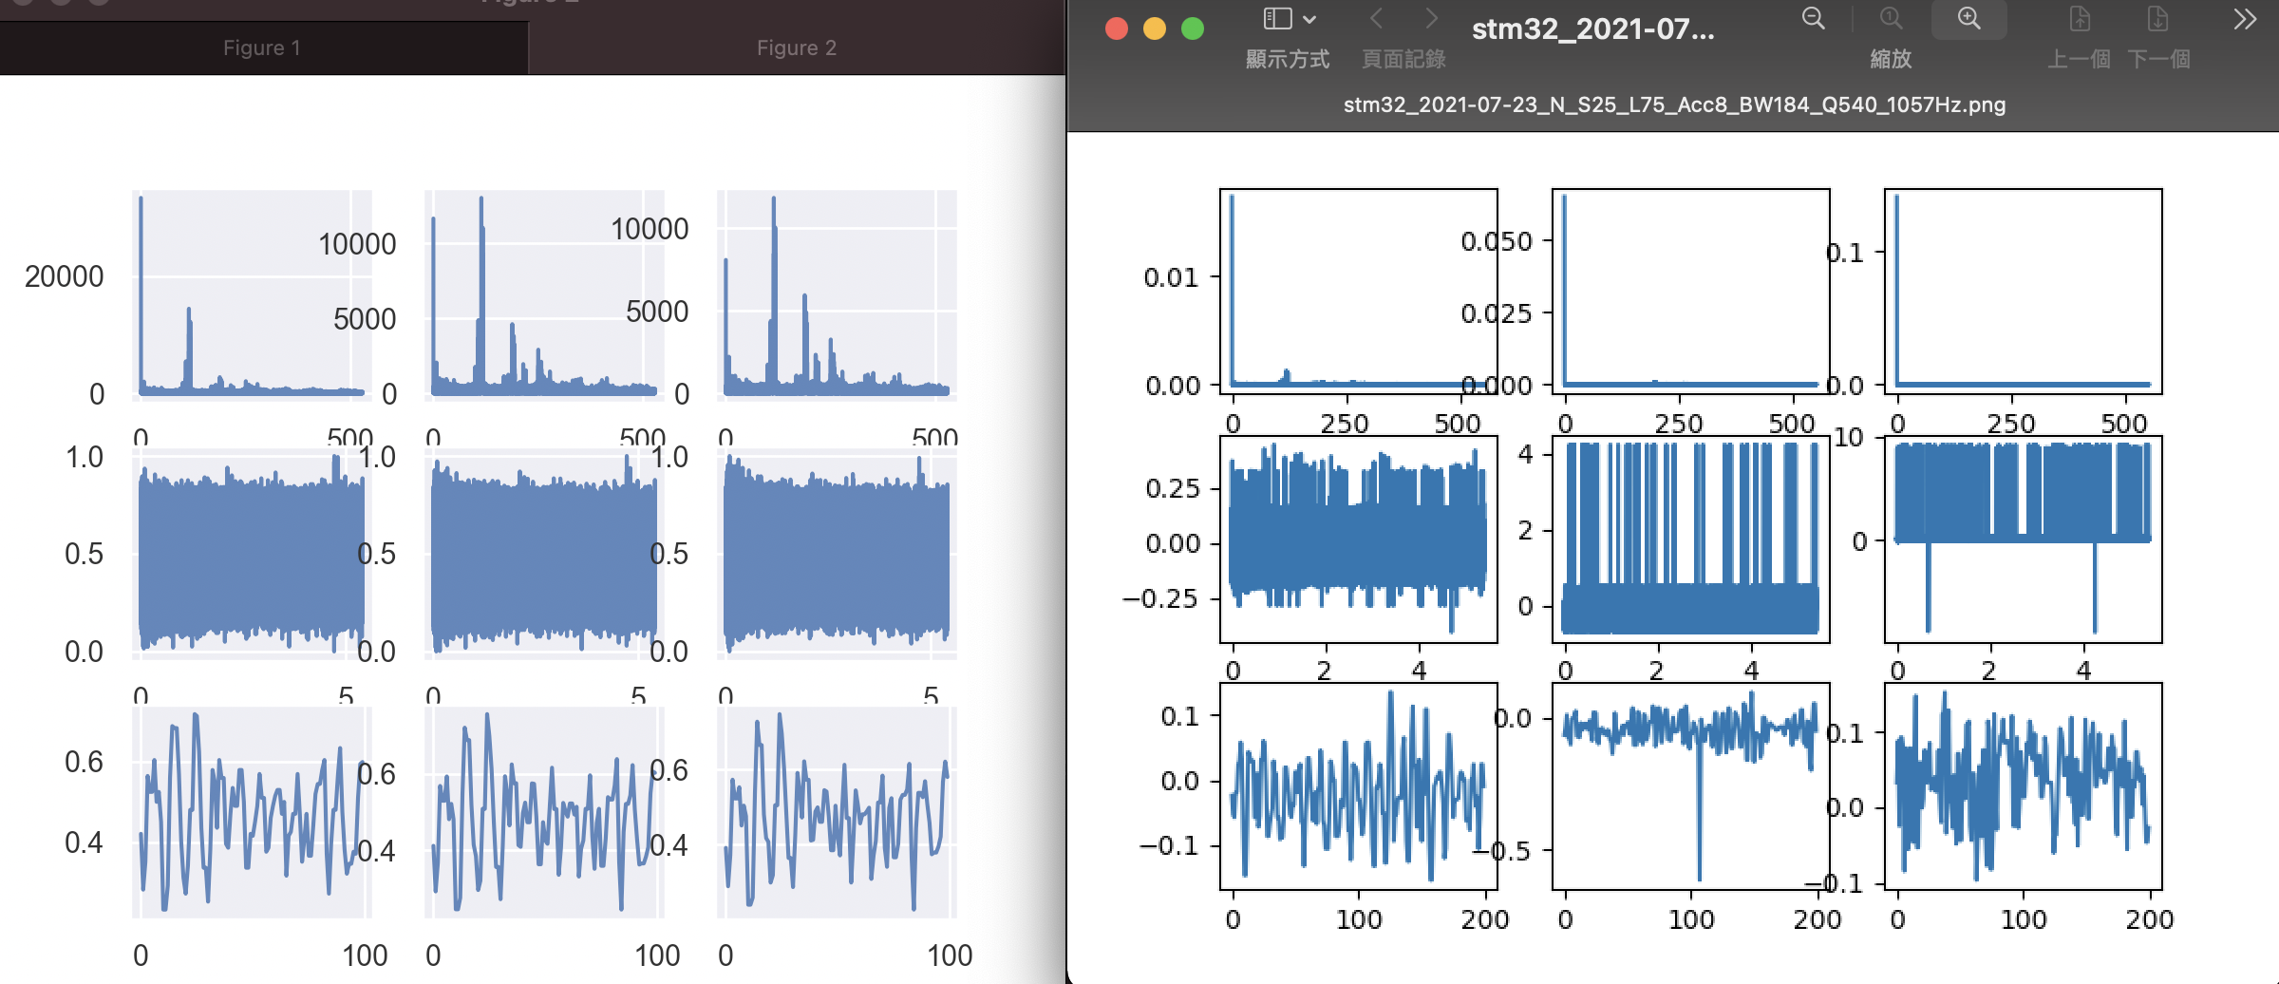

Slide 10
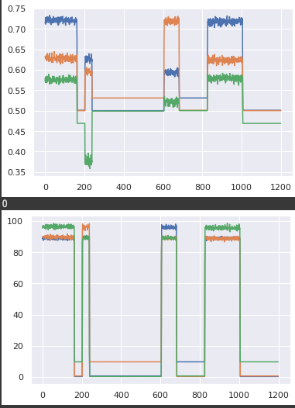
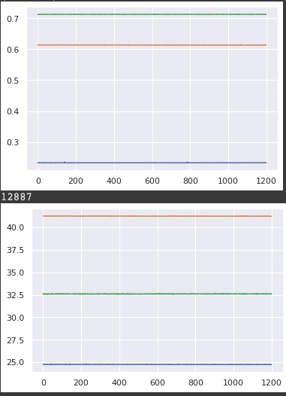

Slide 11
Sensor
Data
Delete
Outlier
Bandpass
Filter
Normalize

Slide 12
